Slide 1
Power BI Large Datasets
How to manage large datasets
Tom Martens @ Data Community Austria 2023
2023-01-13

Slide 2
Inside the box
Who I am
What is a large dataset
Strategies – Pro Licensing
Aggregations
Strategies – Premium Licensing
Hybrid Tables
Incremental Refresh
Things to consider

Slide 3



Tom Martens
25+ years of experience designing analytical solutions using the MSFT data platform
Solution Architect @ Munich Re
/tommartens68
@tommartens68

Slide 4

What is a large dataset?

Slide 5
What is a large dataset?
I define a large (complex) dataset as a dataset that
… does not fit into the available memory
… exceeds the available refresh duration
… holds data that must be available more earlier than a full refresh takes

Slide 6
What is a large dataset?
Some constraints (limitations)
Pro licensing
A dataset can not exceed 1GB of RAM
A dataset refresh must complete in less than 2 hours
Number of parallel dataset refreshes is limited
Premium licensing
A dataset can not exceed 10GB of RAM (this limit can be extended to the available RAM of the capacity)
A dataset refresh must complete in less than 5 hours
The pbix file can not become larger than 10GB

Slide 7
What is a large dataset?
The benefits of Power BI Premium Gen2
Each dataset can grow up to the amount of available RAM of the capacity (of course, this does not mean that multiple 25GB datasets can be in the RAM at the same time, considering a P1)
And many more

Slide 8

Strategies Pro licensing

Slide 9
Large datasets - Pro licensing
From my point of view, there is only one option
Use Aggregations! One of my favorite readings: Mastering DP-500 Exam - Aggregations in Power BI! - Data Mozart (data-mozart.com) Please, keep one thing in mind. Defining aggregations is simple (maybe not easy), but you have to take care of the gap between imported data and the maybe more current detail data ☺

Slide 10
Strategies Premium licensing

Slide 11
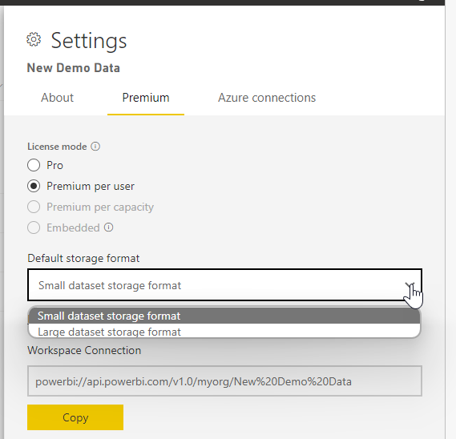
Large datasets - Premium licensing
From my point of view, there is only one option
Enable “Large dataset storage format” Get used to Incremental refresh and if necessary the Advanced Refresh API Maybe you have to use Aggregations at a later point in time!

Slide 12
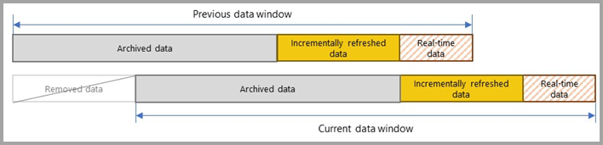
Large datasets – Hybrid tables (Premium)
Hybrid Tables help to reduce the time until data becomes available in Power BI
But you have to be aware that due to the “direct query part” of the table, it will become a DQ table with the known downsides in regards to measure complexity.
Image taken from: Incremental refresh for datasets and real-time data in Power BI - Power BI | Microsoft Learn

Slide 13
Large datasets – Incremental refresh
Incremental refresh is adding data to an existing table!
Increments of data will be added to partitions!
Power BI Service is managing everything, yay!
And of course, we do not want to wait 4.9999 hours, this of course, is one of the reasons why we are using incremental refresh ☺

Slide 14
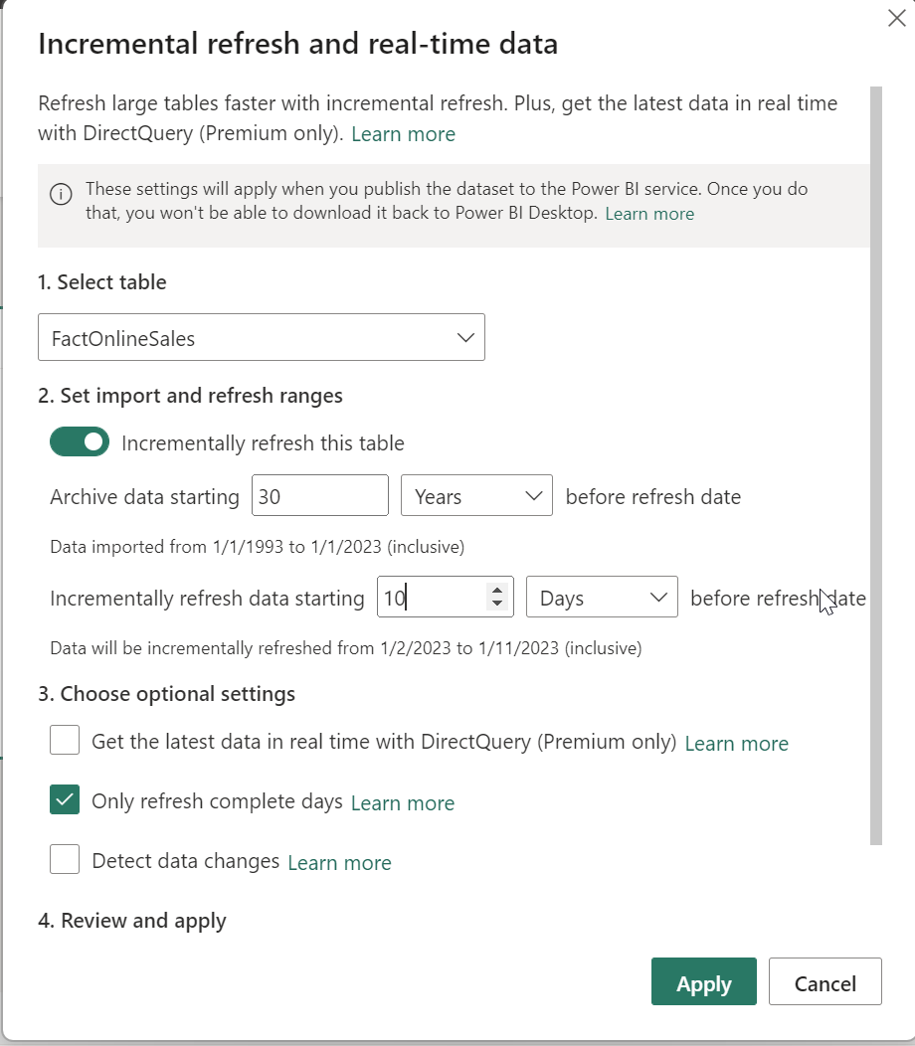

Large datasets – Incremental refresh
At any given time your Power BI dataset will contain 30 years of data?!
Whenever a refresh is executed by the service 10 days before the current date will be queried, this will consider data change in the past 10 days!
This is cool isn’t it?
It really, really is! But …
Find all the details: Incremental refresh for datasets and real-time data in Power BI - Power BI | Microsoft Learn

Slide 15
Large datasets – Incremental refresh Beware of the initial load
On the first refresh issued by the Power BI Service, all the data is queried … … this might lead to a timeout due to the 5 hours refresh limit

Slide 16
Large datasets – Incremental refresh How to avoid the initial load
Watch this video (16) Avoid the full refresh with Incremental Refresh in Power BI (Premium) - YouTube
it’s really simple! Get the amazing ALM-Toolkit: Home Page - ALM Toolkit (alm-toolkit.com)

Slide 17
Large datasets – Incremental refresh How to avoid the initial load
Steps (1/2):
Create a filter inside the Power Query query, that makes the query return NULL rows. Do not use the column you are using for the incremental refresh.
Publish the pbix to the workspace DO NOT REFRESH the dataset inside the Power BI Service

Slide 18
Large datasets – Incremental refresh How to avoid the initial load
Steps (2/2):
Remove the “arbitrary filter” in the pbix Do not publish the pbix to the Service
Use the ALM toolkit to “synch” the metadata change “the change of the underlying M query” ☺ This requires an XMLA endpoint (just to be sure) Do not refresh dataset inside the Power BI Service

Slide 19
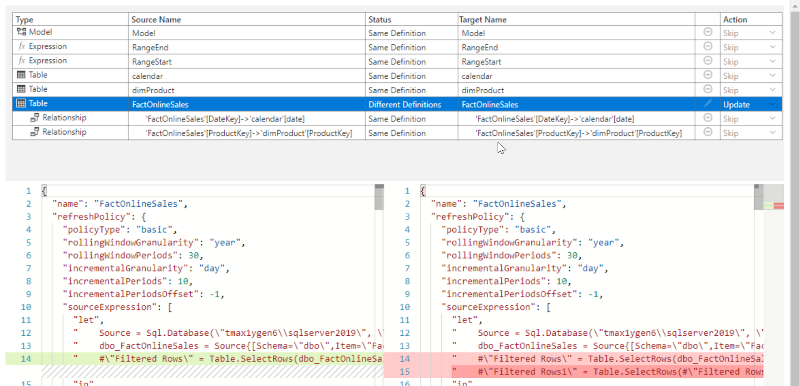
Large datasets – Incremental refresh
ALM Toolkit - Options

Slide 20
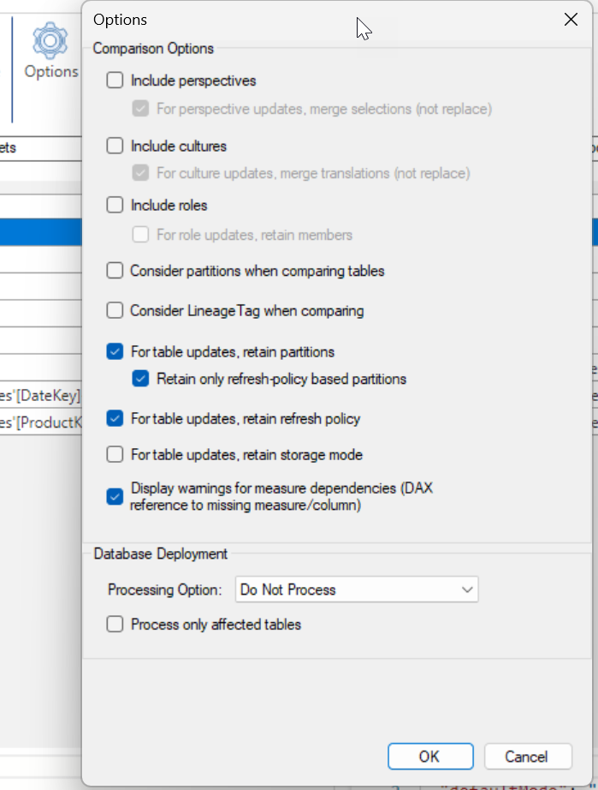
Large datasets – Incremental refresh
ALM Toolkit - Options

Slide 21
Large datasets – incremental refresh
When you are using incremental refresh, please:
Separate data from content → use two pbix files. The content pbix connects to the Power BI dataset
Become a friend of Tabular Editor
Prepare for the “manual” initial load (even if …), this is like “there is no successful backup w/o a successful restore”

Slide 22
Large datasets – incremental refresh
When you are using incremental refresh, please:
Adjust for the manual initial load load as much data with one go
Create a list of effctiveDate(s) ;-)
Run a script!
Adjust the RefreshPolicy after the manual initial load is done → back to normal

Slide 23
Large datasets – incremental refresh
Useful links
Large dataset (setting): Large datasets in Power BI Premium - Power BI | Microsoft Learn
Incremental refresh: Incremental refresh for datasets and real-time data in Power BI - Power BI | Microsoft Learn
Advanced Refresh API: Enhanced refresh with Power BI REST API - Power BI | Microsoft Learn
ALM Toolkit: Home Page - ALM Toolkit (alm-toolkit.com) The ALM Toolkit allows you to update the Power BI dataset without invalidating existing partitions! Of course, whenever the structure of a partitioned table changes, you have to refresh partitions. This might become difficult as the initial load might exceed the 5 hours refresh duration. Now the fun begins ☺
The tabular protocol: https://sqlprotocoldoc.blob.core.windows.net/productionsqlarchives/MS-SSAS-T/%5bMS-SSAS-T%5d.pdf

Slide 24

And now, what?
If you are entering the realm of large datasets you have to understand incremental refresh and the initial load and its limitations, meaning the 5 hours refresh limit (or create custom partioning scheme)

Slide 25
Thank you

Slide 26
The Tabular Editor Script
//{
// "refresh": {
// "type": „dataOnly",
// "applyRefreshPolicy": true,
// "effectiveDate": "02/24/2023",
// "objects": [
// {
// "database": "ManageLargeDatasets",
// "table": "FactOnlineSales"
// }
// ]
// }
//}
//{
// "refresh": {
// "type": "calculate",
// "objects": [
// {
// "database": "ManageLargeDatasets",
// "table": "FactOnlineSales"
// }
// ]
// }
//}
//because this is performing the initial load, the refresh type dataOnly is selected :-)
//do not forget to run a "calculate" AFTER the iteration across all effectiveDate(s), Calculated Columns and Partitions will be created
var type = "dataOnly";
var database = Model.Database.Name;
var table = "FactOnlineSales";
var effectiveDate = "01/01/2007"; //MM/DD/YYYY
var tmsl = "{ \"refresh\": { \"type\": \"%type%\", \"applyRefreshPolicy\": true,\"effectiveDate\": \"%effectiveDate%\" ,\"objects\": [ { \"database\": \"%db%\", \"table\": \"%table%\" } ] } }"
.Replace("%type%", type)
.Replace("%db%", database)
.Replace("%table%", table)
.Replace("%effectiveDate%", effectiveDate);
ExecuteCommand(tmsl);

Slide 27
Large datasets – Incremental refresh Details (some are gory)
Processing the available methods (SSMS → TMSL) Partition
Process full → “refresh”: { “type”: “full” , “objects”: … } Process data → “refresh”: { “type”: “dataOnly” , “objects”: … } Process add → “refresh”: { “type”: “add” , “objects”: … }
Process default → “refresh”: { “type”: “automatic” , “objects”: … } Process clear → “refresh”: { “type”: “clearValues” , “objects”: … }
Process Recalc → “refresh”: { “type”: “calculate” , “objects”: … } calculates the dependencies and calculated columns
Table
…
Process Defrag → “refresh”: { “type”: “defragment” , “objects”: … }

Slide 28
Large datasets – Incremental refresh
Incremental refresh is adding data to an existing table
{
"refresh": {
"type": „dataOnly",
"applyRefreshPolicy": true,
"effectiveDate": "02/24/2023",
"objects": [
{
"database": "ManageLargeDatasets",
"table": "FactOnlineSales"
}
]
}
}

